Slide 1
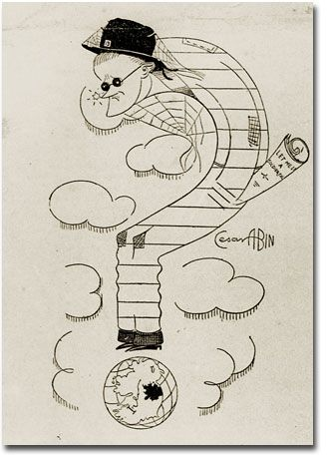
Making as Knowing differently
- Do we fully know what we make?
- When do we know it?
- How do we write it?

Slide 2
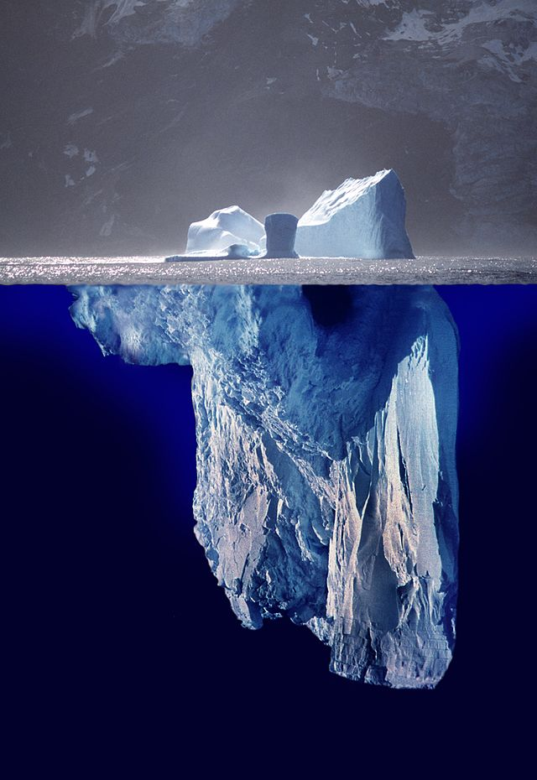
Why liken your project to an iceberg?
‘The dignity of movement of an iceberg is due to only one-eighth of it being above water.’
‘the knowledge is what makes the underwater part of the iceberg.’
Hemingway

Slide 3
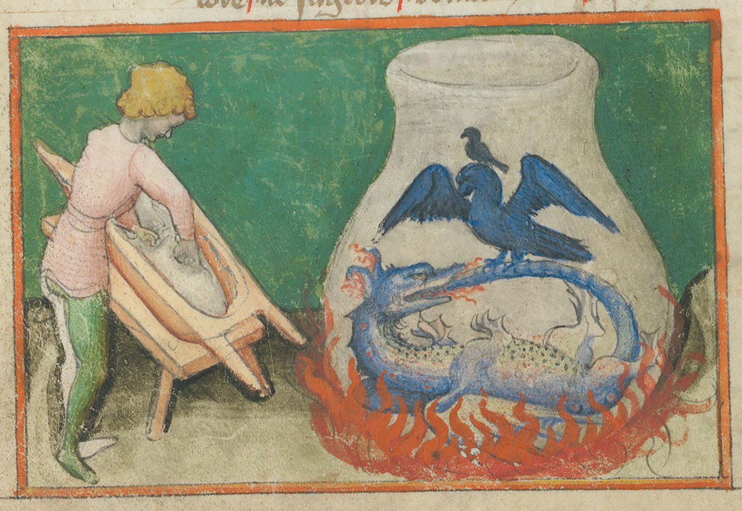
Alchemy (in reverse?) – turning lightness back to weight
Depiction of an Ouroboros from the alchemical treatise Aurora consurgens (15th century), Zentralbibliothek Zürich, Switzerland

Slide 4
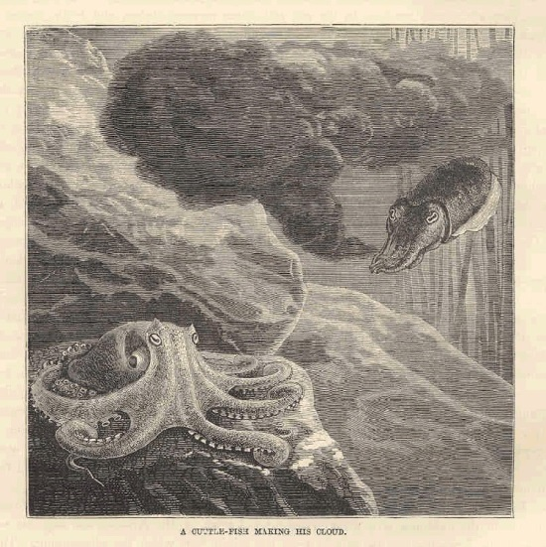
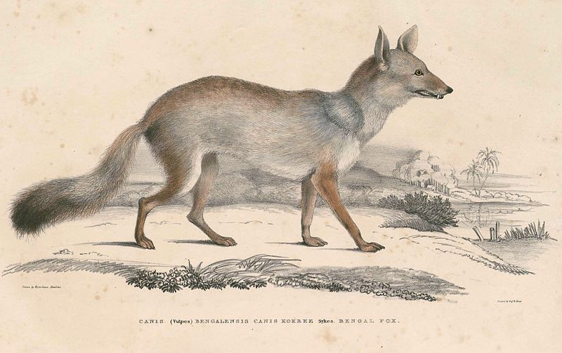
Creative Stealth
- Metis
- Cunning Intelligence

