Slide 1


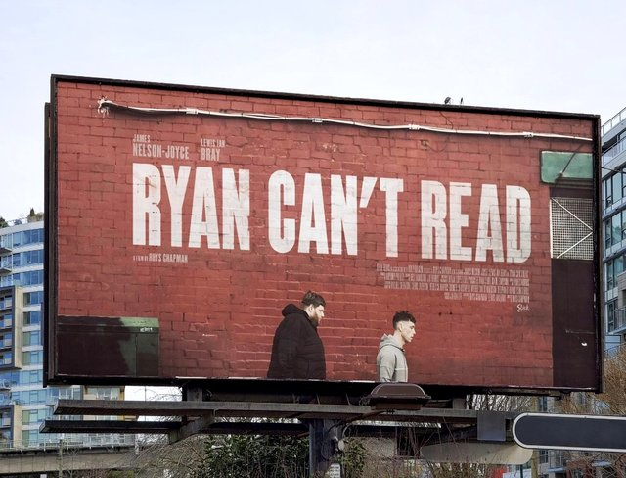
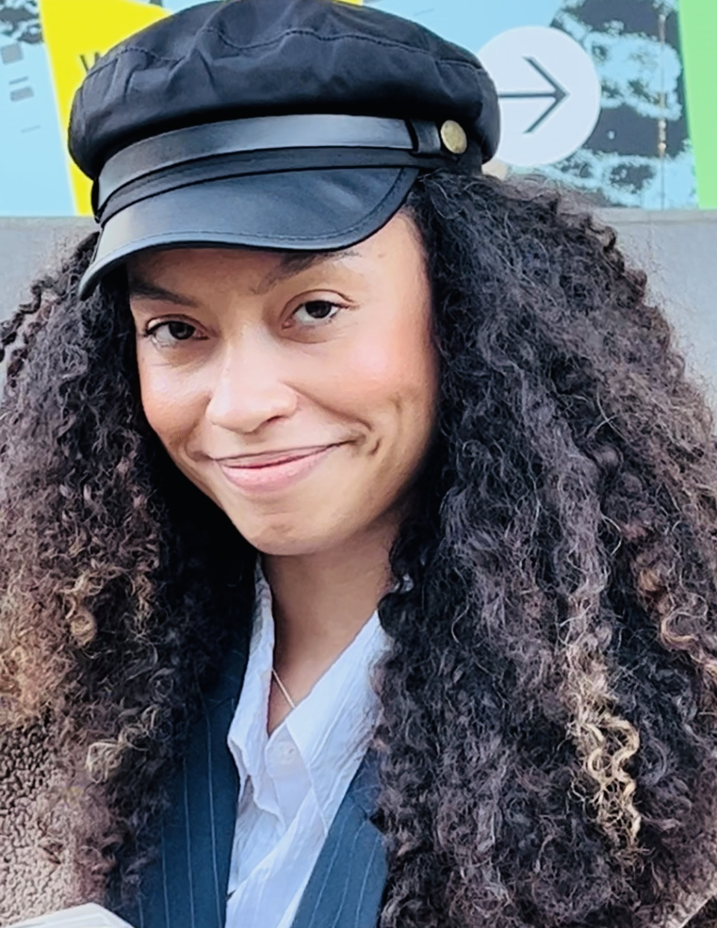


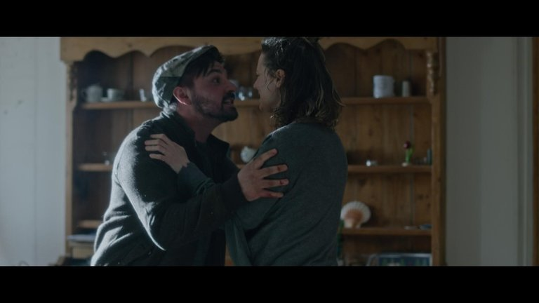
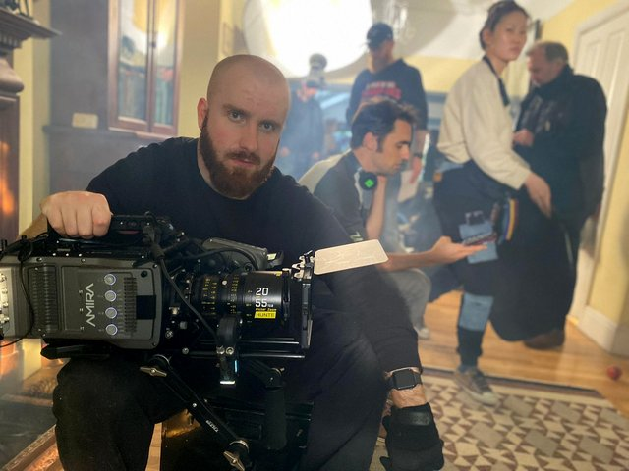


Jason Lee 2022-2024 No. IF220089 British Academy Innovation Fellow –
Meeting the Skills Gap in the Creative Industries focusing on disability equality.

Slide 2



