Slide 1

Non-standard outputs: Their merits, the REF and the Funders DMU 13 March 2024
Individual and collaborative
experimental sound-based composition and sampling
Leigh Landy

Slide 2
Non-standard outputs: Their merits, the REF and the Funders DMU 13 March 2024
Individual and collaborative
experimental sound-based composition and sampling
Dissecting the title of today’s event in terms of this presentation
• Non-standard outputs (practice-based research in the arts within Higher Education, ’the thinking artist’ – NB: I am not speaking about industry/ science)
• Their merits (art as research, art as cultural and societal driver)
• The REF (research imperative)
• & External funders (e.g., ACE vs. AHRC)

Slide 3
Non-standard outputs: Their merits, the REF and the Funders DMU 13 March 2024
Individual and collaborative
experimental sound-based composition and sampling
Dissecting my chosen title for this short presentation
• Individual and collaborative …
• Experimental sound-based composition
• & Sampling (and its associated legality issues; art challenging society)

Slide 4
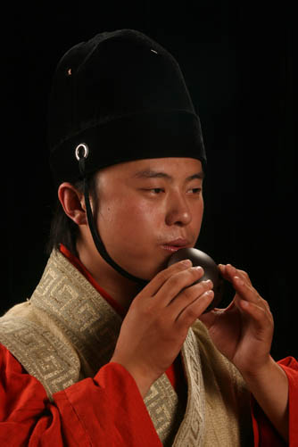

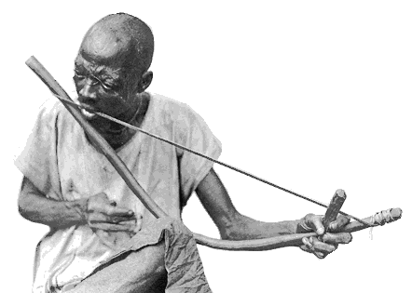

Non-standard outputs: Their merits, the REF and the Funders DMU 13 March 2024
Individual and collaborative
experimental sound-based composition and sampling
Two ultra-brief examples
• What I call music-based music, the {Instrument/Country} Old / New Series
• Using any sounds, in this case using BBC broadcasts, the Radio Series

Slide 5
Non-standard outputs: Their merits, the REF and the Funders DMU 13 March 2024
Individual and collaborative
experimental sound-based composition and sampling
A few key points to keep in mind:
• Research imperative and its relationship with REF criteria (the REF criteria: originality, significance, rigour)
• Documentation (do not underestimate its importance)
• Dealing with collaboration in terms of the REF (defining roles wherever possible)
• A series as a multiple-output, perhaps double-weighted submission
• Impact of practice-based research (on one of our Impact Case Studies in the last REF which received a 4*)
• + A final word

