Slide 1
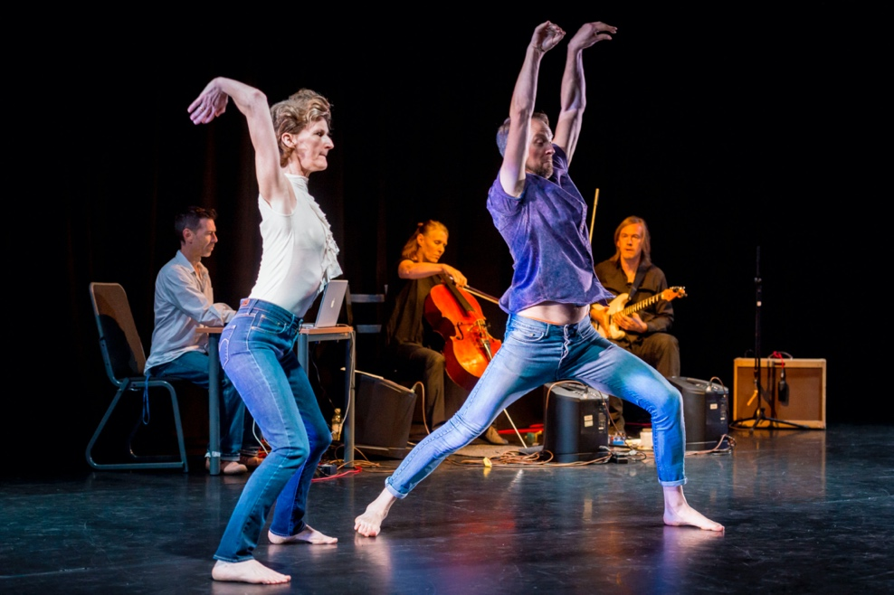
Sally Doughty, Associate Professor Dance, DMU Practice research in Dance and multi-component outputs: articulating them for REF
300 word statement
Contextual document

Slide 2
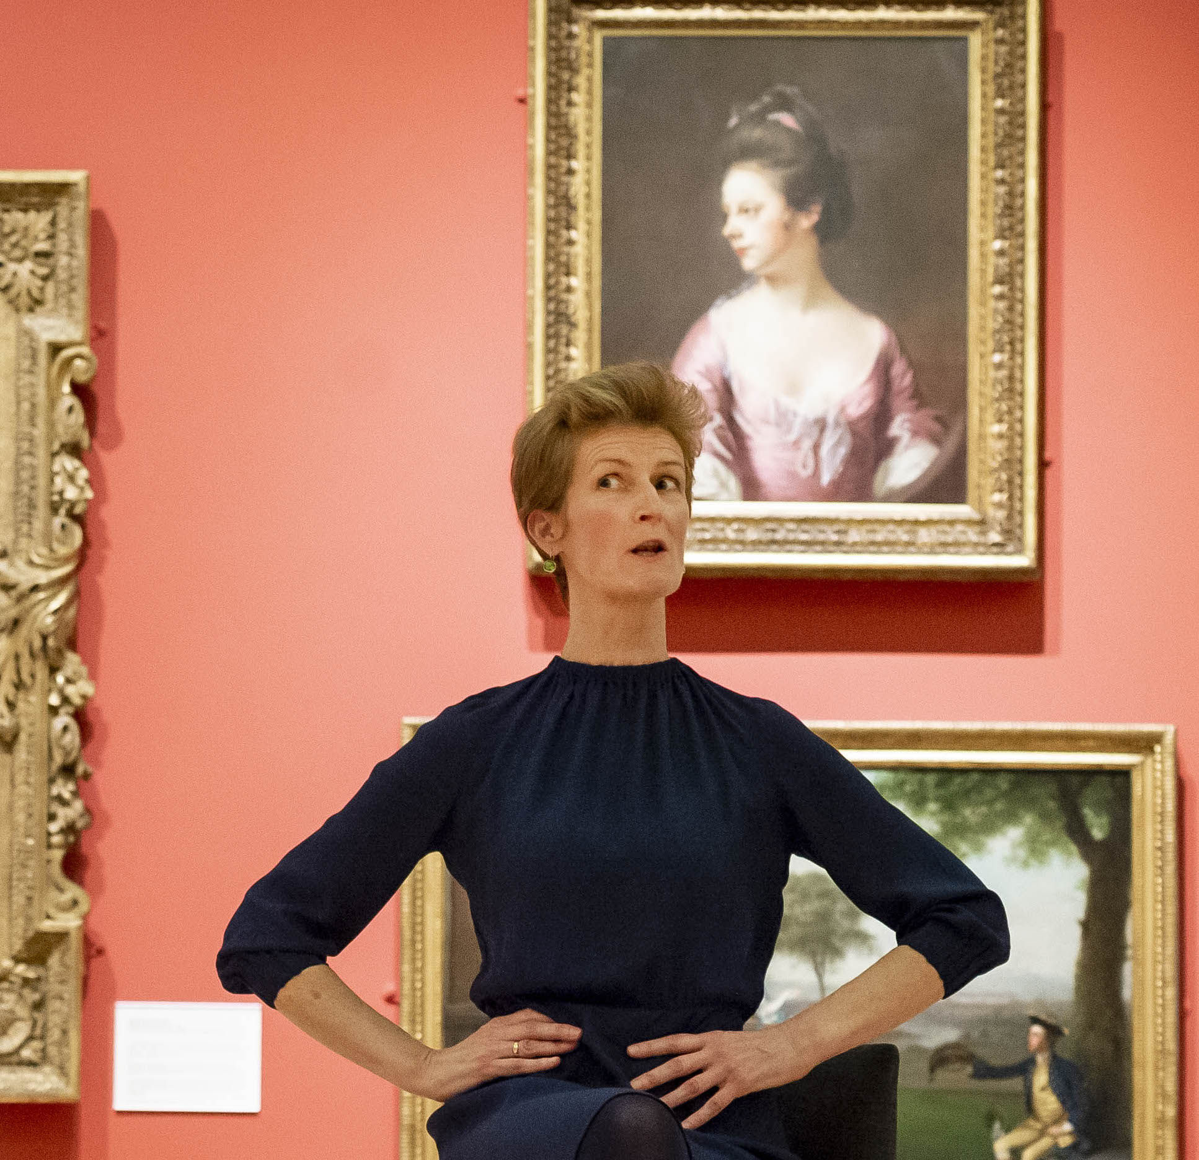
300 word statement
Outputs included
Meta aim
Aims
Context/background
Challenges/research questions
Reference to outputs
Significance to field
Contextual document: 1733 words
Introduction
Context
Research Questions
Methods/Processes
Insights
Dissemination
Appendices
E: sdoughty@dmu.ac.uk

