Slide 1

Embodied Impacts:
Introspections on creativity in sensitive spaces
Dr Anoop Bhogal-Nair
Anoop.Bhogal-Nair@dmu.ac.uk
Faculty of Business and Law

Slide 2
What is ‘sensitive’?
To me? To others? Who defines what is ‘sensitive’?
The definition of a ‘sensitive’ research topic is dependent on both context and cultural norms and values.
Uncomfortable spaces and engaging with the uncomfortable as part and parcel of conducting research.
Projects which may not at the outset be positioned as ‘sensitive’ research may transform. It is always good practice to think around the possibility of this.
For example, issues that once shared might cause stigmatisation. E.g., perceptions around sex before marriage and homosexuality within an Indian context.

Slide 3
Spaces and related considerations
Minoritised groups
religious minorities.
Turban wearing Sikhs in Britain
Sensitivities: stigma, trauma, racism, collective memory, violence.
Disenfranchised groups
specific caste groups in India
The Adivasi, Dalit, and Hijra (LGBTQ) community
Sensitivities: political, stigma, historic violence/ oppression
Disability
The role of disability and marketplace access.
(Transformative Consumer Research – TCR)
Sensitivities: Language(s) and lived realities, representation
Rural and Urban India
Ethnographic work in India within an all-girls college in New Delhi.
Examining ‘modernities’ across rural and urban young women.
Sensitivities: geographic location, times, caste, friction between groups, lived realities, GBV
Gender-based violence
Arts-based intervention strategies to mitigate.
Slum-dwelling migrant women and Hijra (LGBTQ) community
Sensitivities: stigma, trauma, violence

Slide 4
“It is so much more than just signing a form to say that they are willing to offer you information, they are actually allowing you into their lives, they are telling you personal information that might be quite hard, so you need to demonstrate a certain degree of discretion, of respect, of appreciation for what they are doing because the reality is that it is more than just words”
(Dickson-Swift et al., 2007)

Slide 5
Notions of Value and benefits
Impact is defined as 'an effect on, change or benefit to the economy, society, culture, public policy or services, health, the environment or quality of life, beyond academia’ (REF Impact – UKRI)
Concordat on Open Research Data - defining research data as “the evidence that underpins the answer to the research question, and can be used to validate findings regardless of its form”
Push forward the case for embodied impacts – as lived, as felt, as engaged with.
The ways in which bodies navigate the world
What is considered ‘valuable’ in the research world? ‘Hard’ evidence (stats), replicability (to scale up), macro impacts at policy/practice/governance.
Placing ‘human’ back into research (e.g. market research)
Knowledge resides beyond formalised parameters as dictated by research paradigms – in a similar vein, creative outputs should be considered as viable forms of knowledge production through the eyes of lived experience communities.

Slide 6
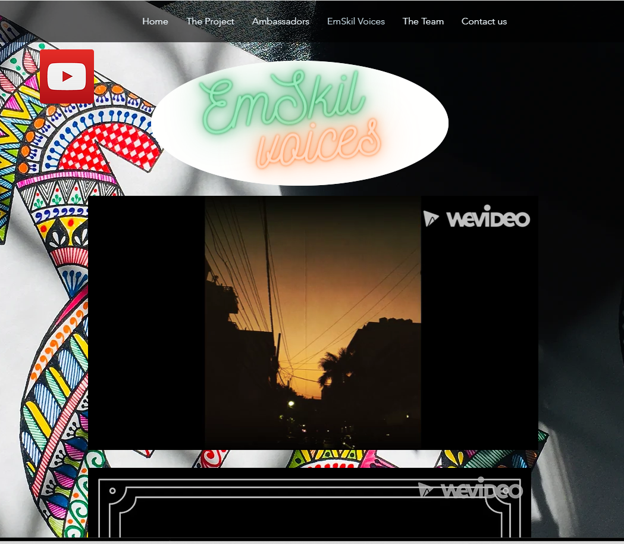
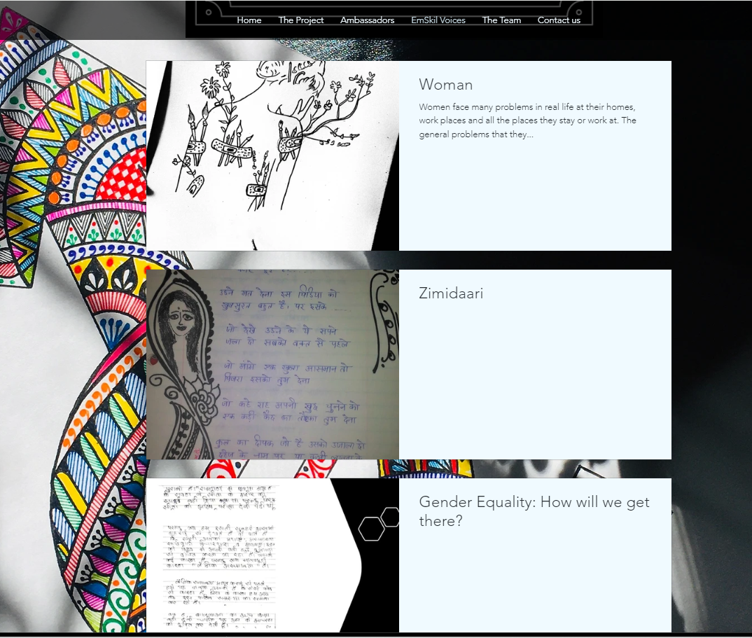

Slide 7
Poetic spaces
Hess (2015, p. 3), discussing the oral traditions and performance of poetry in India, notes how ‘as purely textual scholars, we dealt only with words; now words and music are inseparable. Mind and body interact . . . the meaning of the text change when we hear it sung’. Poems are the craft of emotion, of engagement with context and multiple subjectivities. Faulkner;s (2007, p. 230) comprehensive analysis on research poetry as craft further highlights the need to engage with the embodied experiences that ‘make audiences feel with, rather than about a poem’. It is this very notion which positions poetry as a resonant method (Paiva, 2020, p. 4), capable of revealing the ways in which ‘bodies echo in the world’ (Bhogal-Nair, 2022).

Slide 8

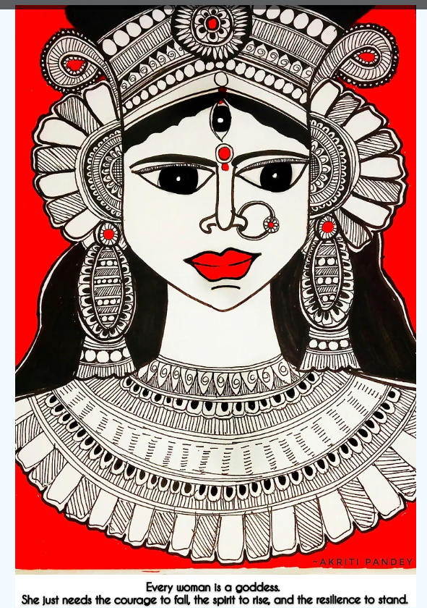

Slide 9
The case for creative outputs
Increasing number of calls for embedding creativity – health research, transformative research, community-based action research, transdisciplinary research, international development contexts
Art-based research - exploring peoples’ subjective experiences, abstract concepts where verbal descriptions may not be sufficient, sensitive topics focused on exploring feelings and emotions, different languages, people with communication difficulties, or groups with mixed abilities.
Making use of the body as part of the space. Human beings are inherently creative.
Forms of embodied creativity - creative expressions and processes that emphasize or are generated by the physical body.
‘data’ and ‘evidence’ as disembodied. Creative expression allows for an engagement with the senses and the body.
Exhibitions
Digital stories
Poetry
Artwork
Blogs and opinion pieces
Performance and applied theatre

Slide 10
Structural constraints and concerns
Ethics and DPIA (data protection impact assessment)
Barriers in understanding and communicating non-conventional/non-standard methods.
Rules-based approach to ethics. In other words, the focus is upon ethical absolutes (informed consent, confidentiality, avoidance of harm).
Push for situation-based and ethics. Leading by context
Inherent Eurocentricity of the ethics process
Messy ethics adheres to the feelings, experiences, and processes within projects fraught with chaos. Messiness is a communicative space of co-labouring.
Balancing protection and participation.
Ethics as a process, not an event.
Challenging methodological myopia in relation to human subjects
Ethics frameworks have tended to emphasise participants rights to protection over their right to participate.

Slide 11
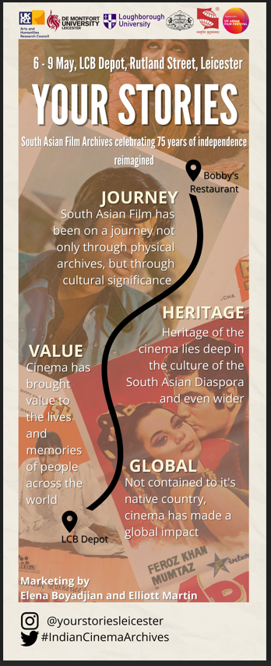
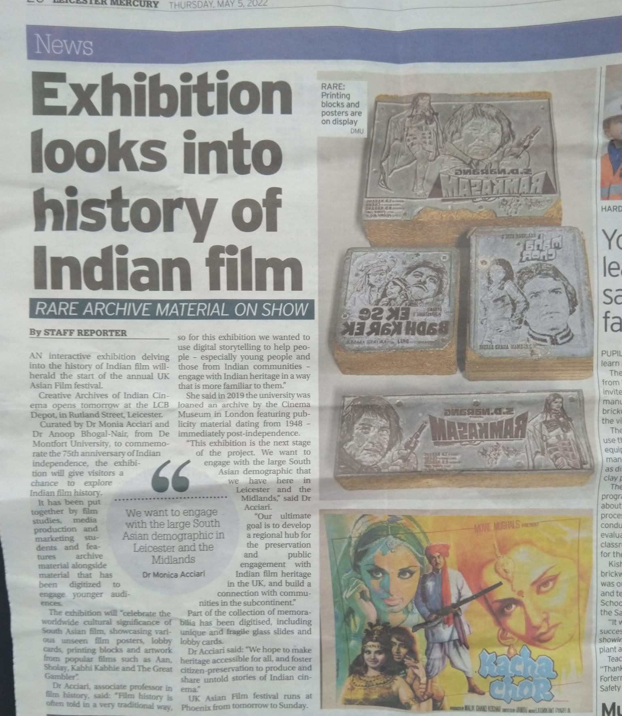
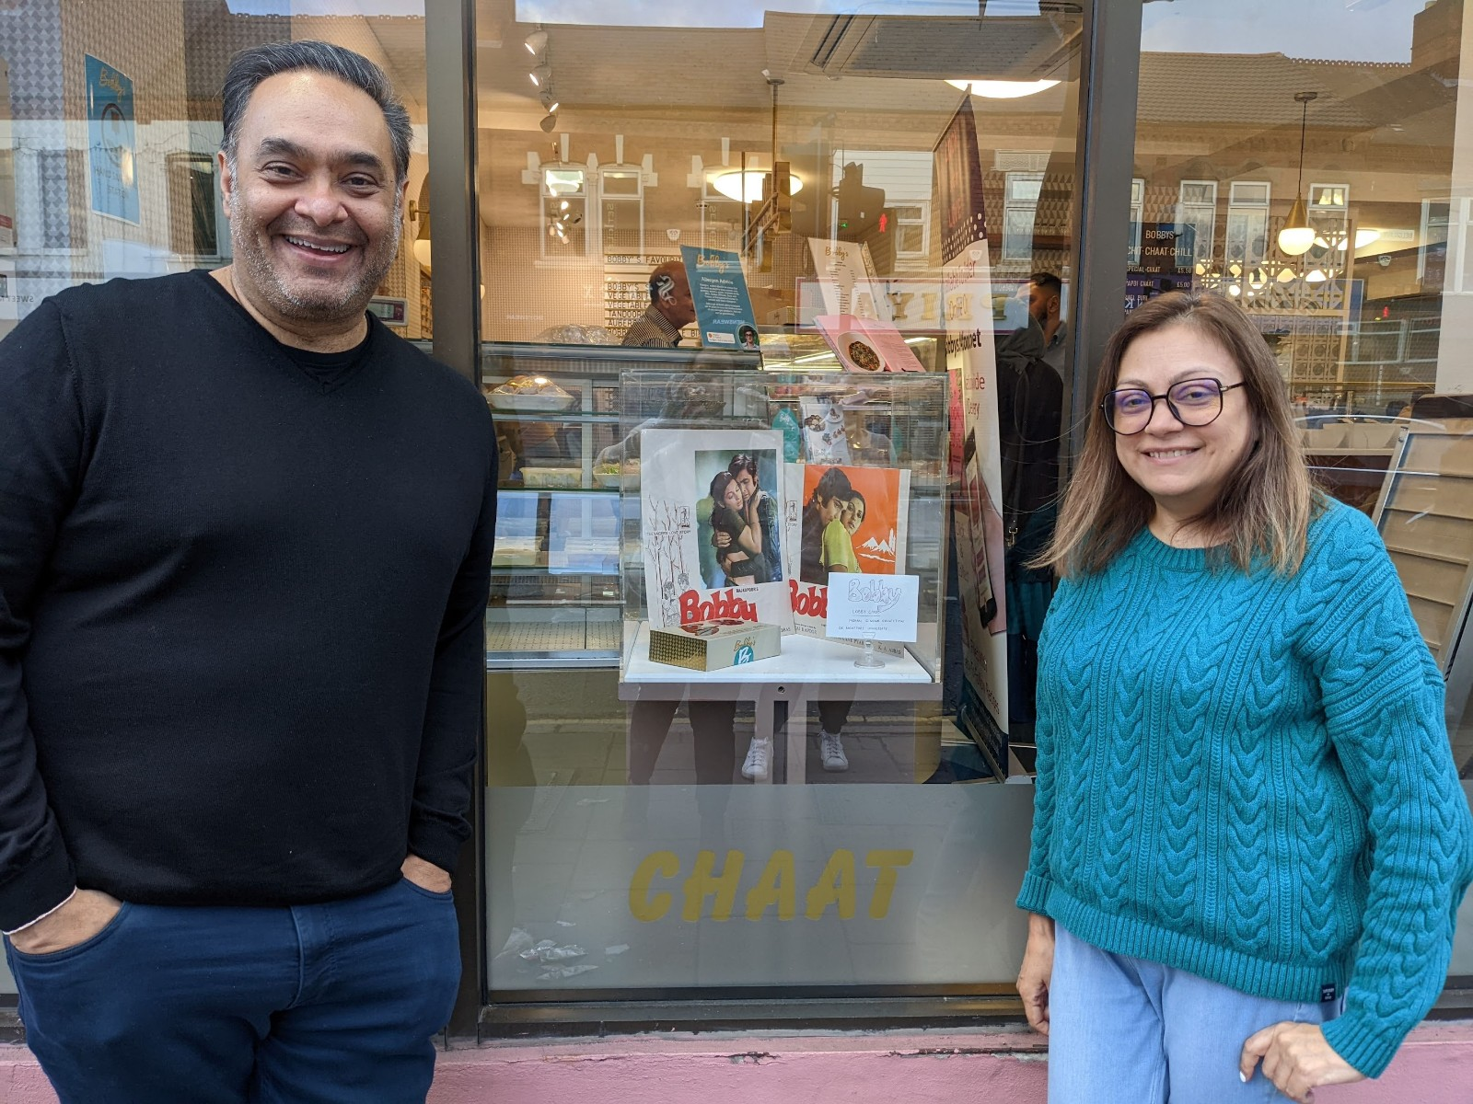
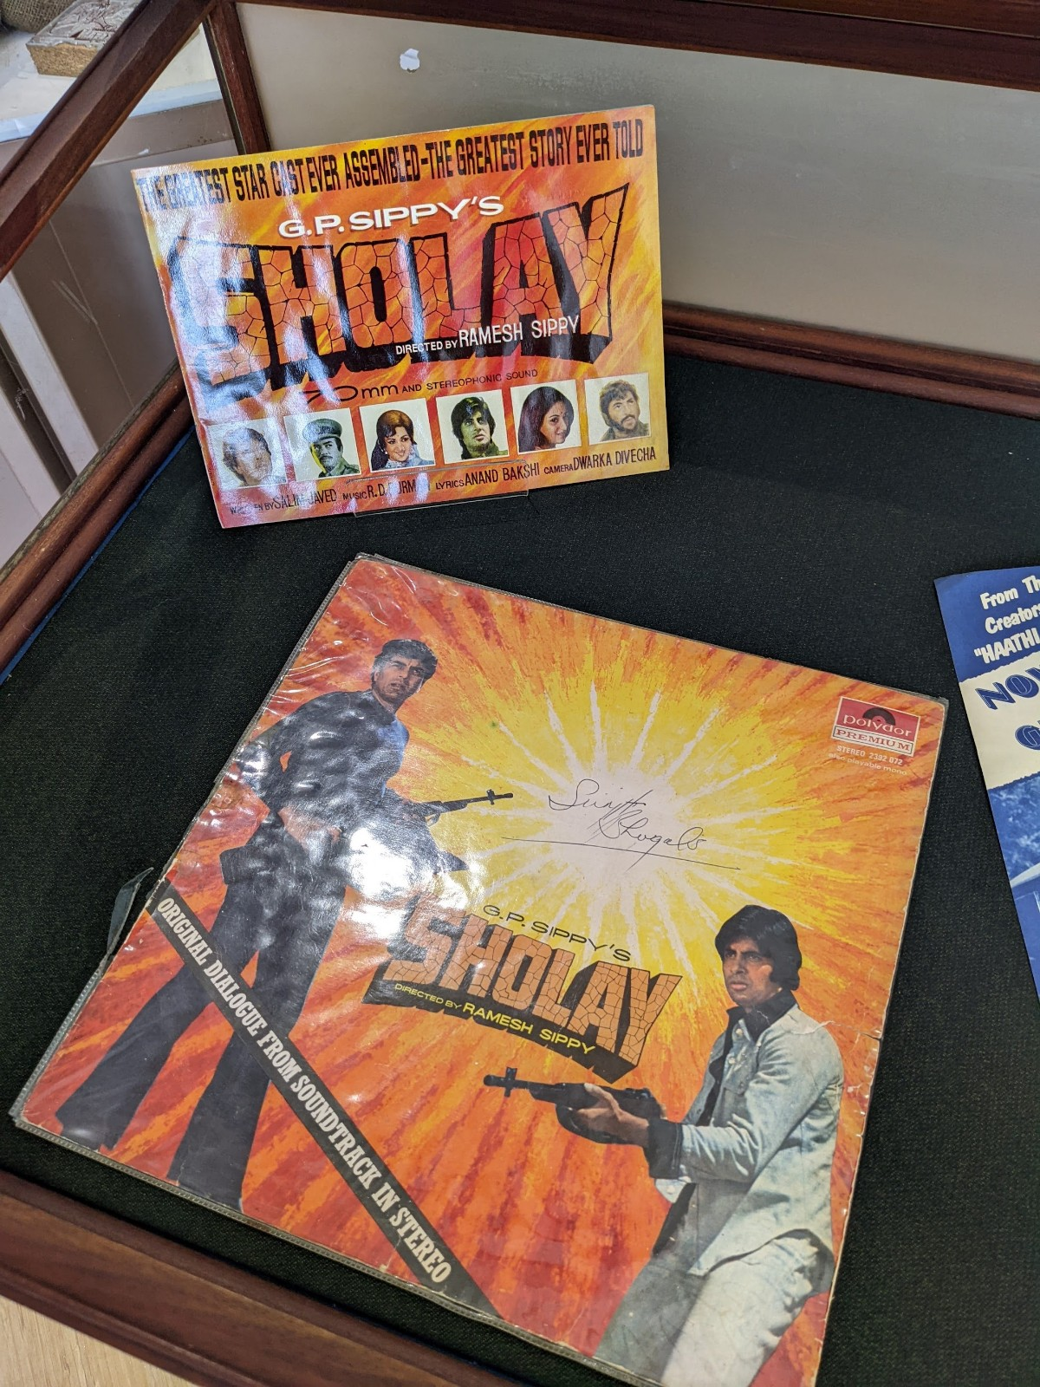
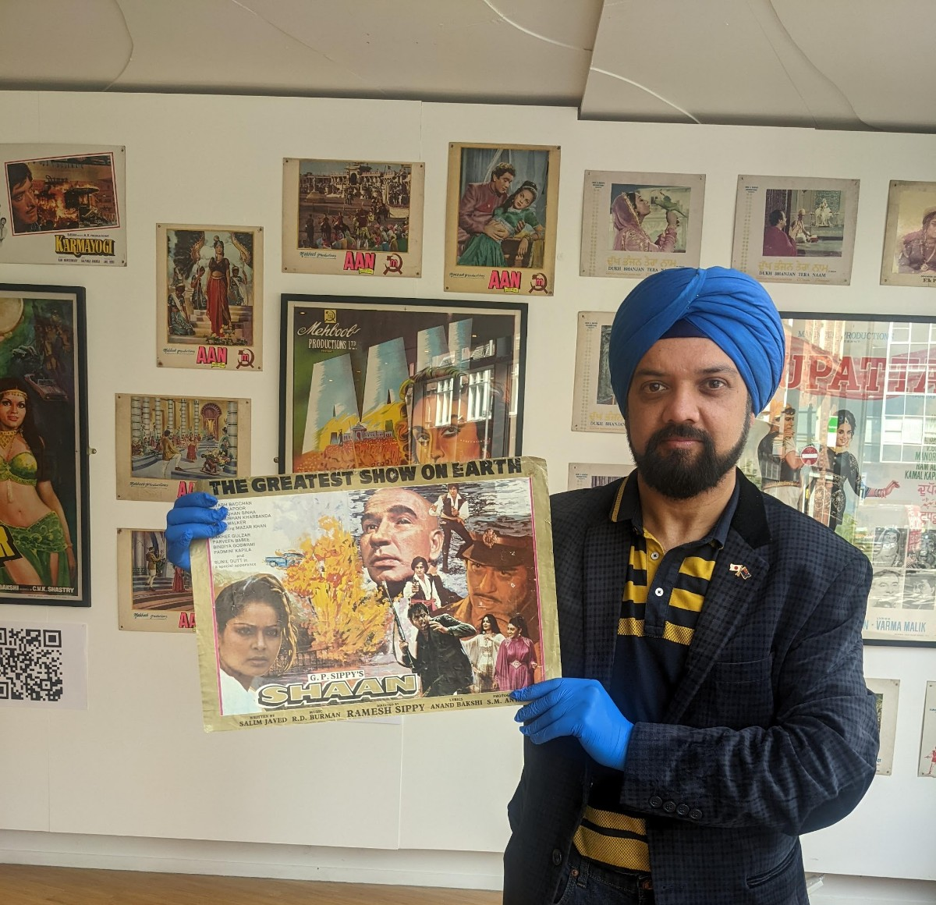
The lived experience of heritage through film for the South Asian diaspora.
Engagement with:
community members (collectors)
Local businesses
Local media
Students

Slide 12
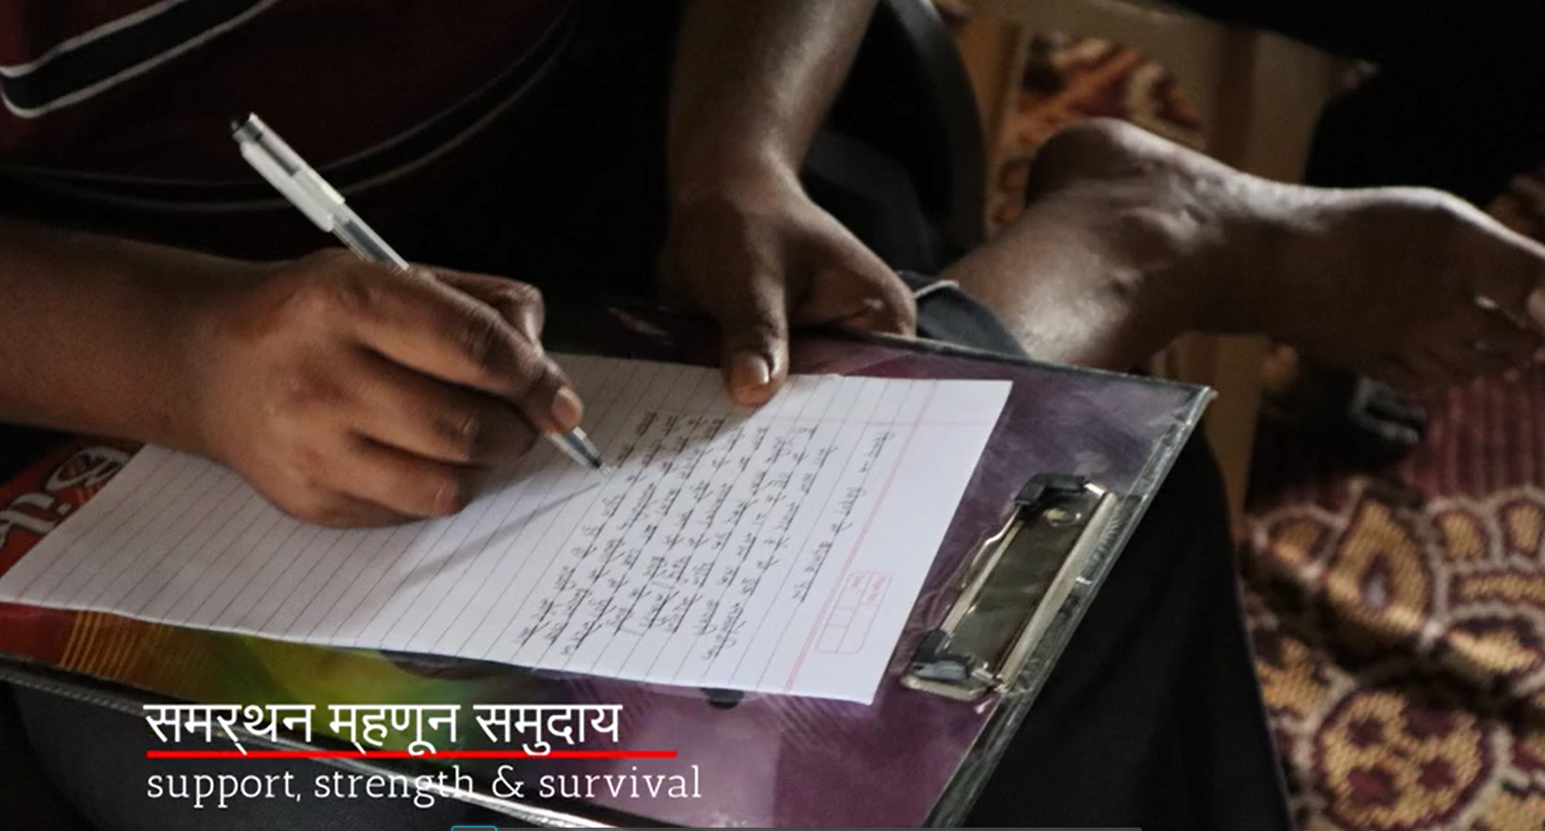
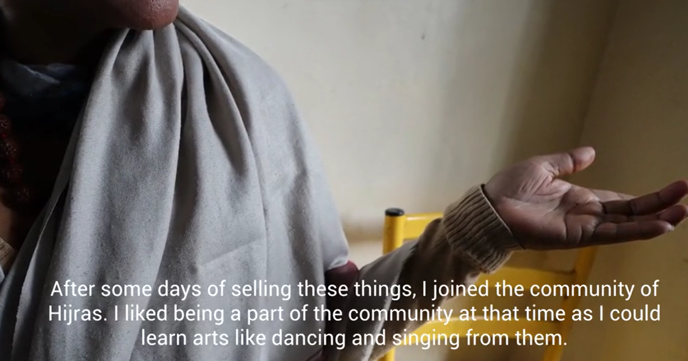
Digital Storytelling
Digital storytelling combines the art of storytelling with multimedia features such as photography, text, audio, voiceover, and video, usually 2-3 minutes in length.
The power of a story – human memory is story-based, we access our world through episodes and narratives. We are perpetual storytellers.
Allows for real, lived, intimate portraits – empowered/agentic approach where the output is curated by the storyteller
Increasing usage within development-based contexts

Slide 13
Value and Impact (for who)
“I felt seen, and I felt heard. I realised that there were more people in my situation and that gave me hope, it gave me strength. I really enjoyed the event here and I really hope that we can come together like this again”
“I am so glad you set up this exhibition. This is my childhood, these are my memories, this is how we used to connect to India. It’s all on show and it is wonderful”
“This is my story. I want you to tell my story. Not just what I endured, but the whole story so that I can give hope to another woman, I can tell her this is not the way to live”
“we all came together as friends in the community…old memories, chatting, songs and experiences were shared with each other. This freed the mind and awakened a positivity”

